Slide 1

The Rise of Autonomous Vehicles
Cars and drones are transforming transportation.
-s.sriram naik
-22071A6751

Slide 2
Introduction
Self-Driving Cars
Autonomous Drones
Impact and Future
Reshaping personal transport.
Revolutionizing various industries.
Exploring current trends and future.

Slide 3
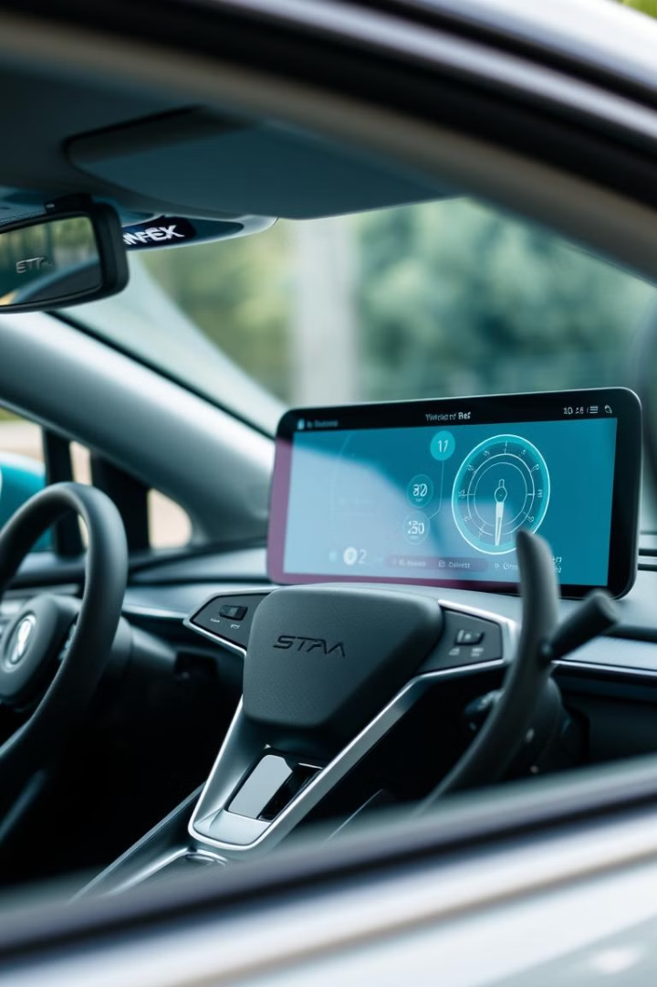
Autonomous Cars - The Evolution
1
AI & Sensors
Enable navigation and decision-making.
2
Key Players
Tesla, Waymo, Uber lead innovation.
3
Current Features
Autopilot and adaptive cruise control.

Slide 4
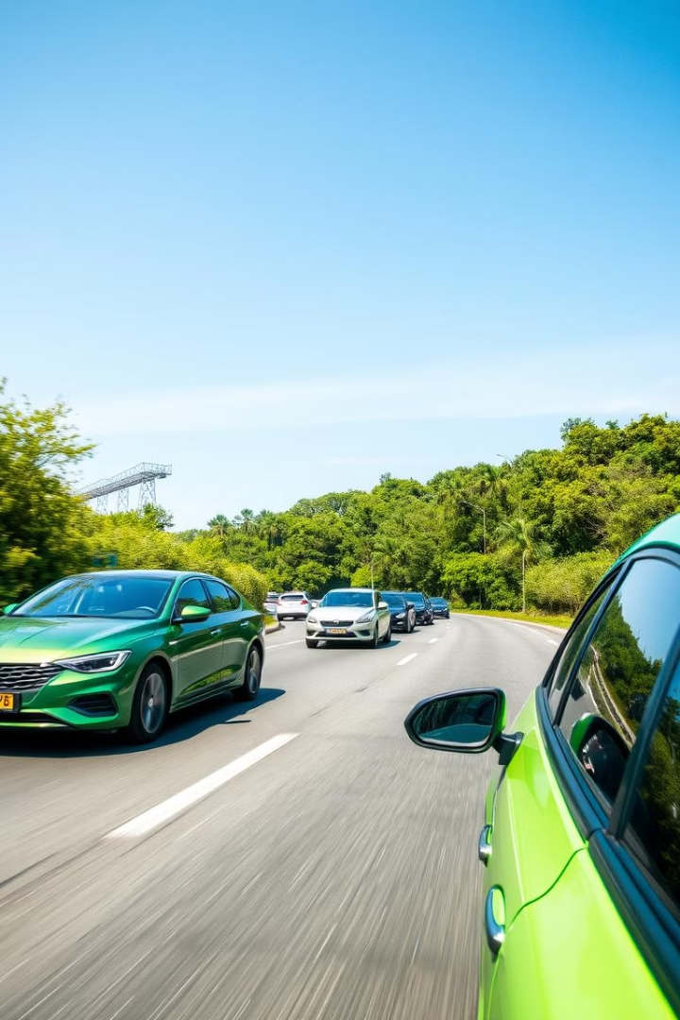
Benefits of Autonomous Cars
1
Safety
Fewer accidents.
2
Efficiency
Reduced traffic and commute times.
3
Environment
Optimized driving reduces pollution.

Slide 5
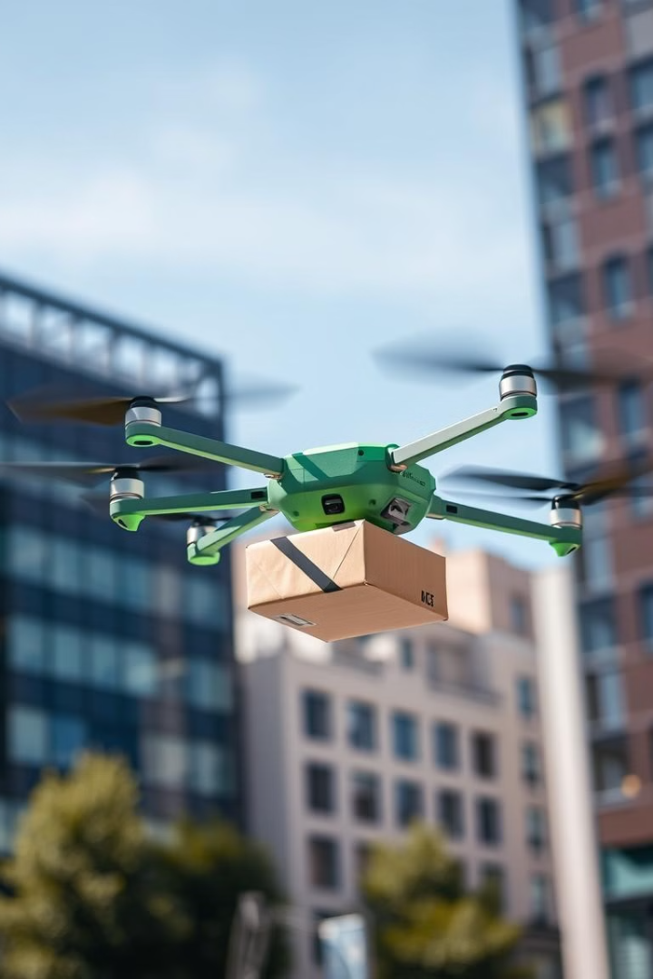



Autonomous Drones - Taking Flight
Delivery
Faster and more efficient.
Surveillance
Enhanced security and monitoring.
Emergency Response
Rapid assistance.

Slide 6
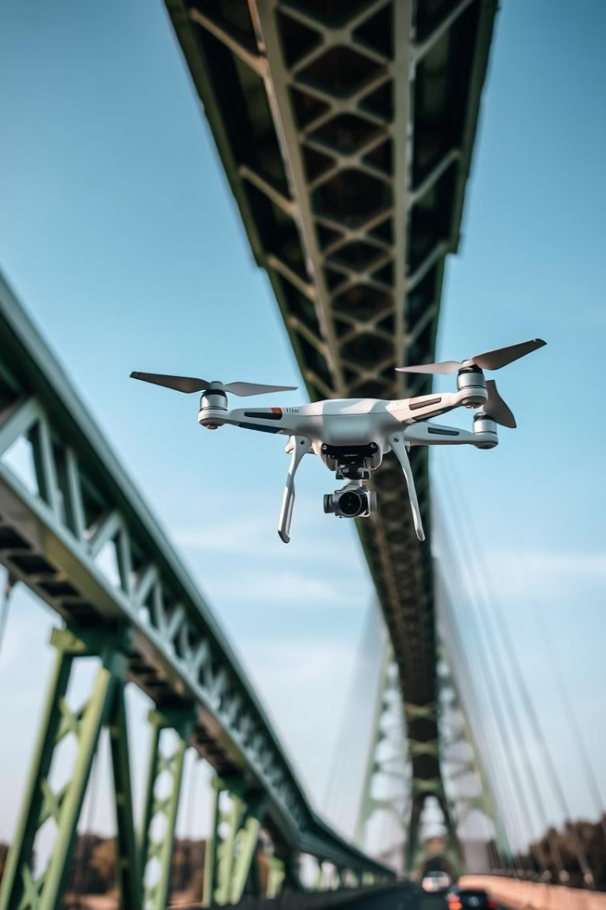
Applications of Autonomous Drones
Delivery
Quick and efficient transport.
Agriculture
Crop monitoring and pesticide application.
Emergency Services
Search and rescue operations.
Infrastructure
Bridge and power line inspections.

Slide 7
Challenges Facing Autonomous Vehicles
Technical
Regulatory
Ethical
Unpredictable conditions and sensor accuracy.
Evolving laws and safety standards.
Complex decisions in critical situations.

Slide 8
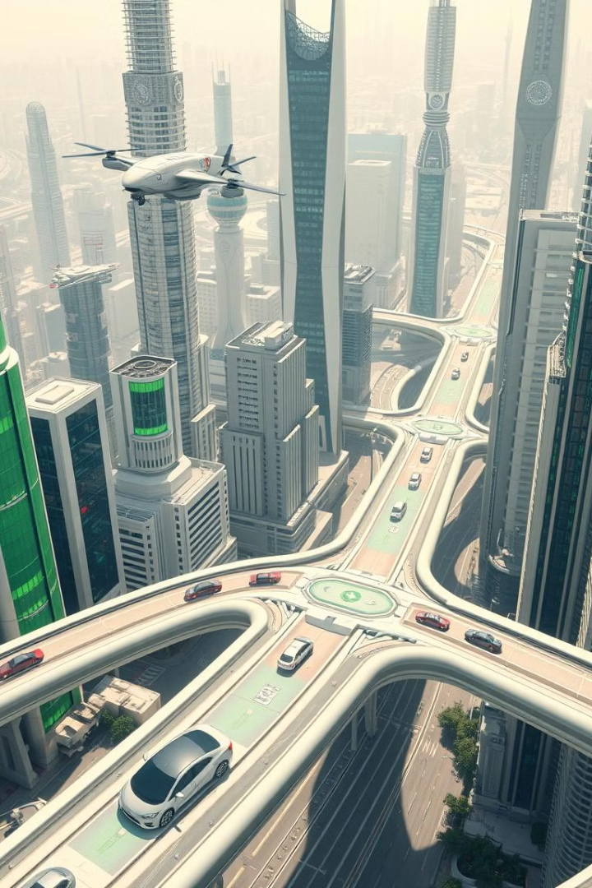



The Future of Autonomous Vehicles
Level 5 Autonomy
Fully autonomous cars.
Drone Expansion
Growth in logistics and healthcare.
City Adaptation
Infrastructure and regulations will adapt.

Slide 9

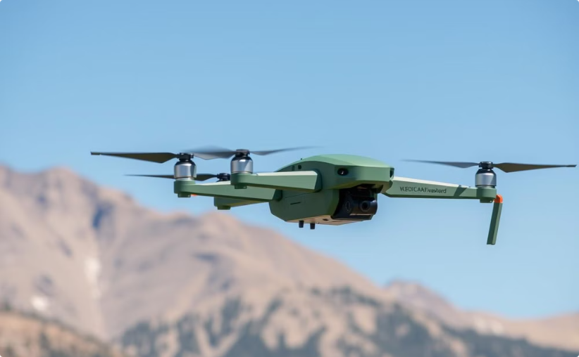
Conclusion
Transformative Potential
Evolving Landscape
Reshaping transportation.
Technology and regulations will adapt.

